Slide 1


Emergency Information Council
at Leisure World Seal Beach
Solving for emergency Resident communications
Interact Technologies - Confidential & Proprietary - 2024

Slide 2

What happens if there is a disaster?
Simply put, you are on your own
Power is off
Mobile phone towers are down
No Internet access
How do you reach someone, help?
There may be a few short-range Family Service Radios to contact the Leisure World Emergency Operations Center (EOC)
How will they find you and know your location?
If you are stuck inside and hurt – how will they know?
How do we solve for this problem going forward
It starts with implementing property-wide managed Internet
Insuring battery backup so Internet doesn’t fail when the power goes off
Creating redundancy so multiple communication paths exist
Downloading a free Leisure World Help Chat app
mitigating the problem of disaster communication readiness
Interact Technologies - Confidential & Proprietary - 2024

Slide 3
Leisure World Disaster Help Chat
Importance of Managed Internet
Deployment of enterprise Wi-Fi access points
Allows for Cellular off-load of voice traffic – not cellular tower
Can connect IoT (Internet of Things) devices (i.e. fall down devices)
Resident can use wherever managed Internet is installed
Importance of Redundancy and Battery Backup
Battery back-up ensures Internet works even when the power fails
Solar will recharge battery so Internet will work for days
Redundant Internet circuits mean if one fails, you still have Internet
Implementing the Leisure World Disaster Help Chat app
Download the free Leisure World Help Chat app
Text messages will be sent to the Leisure World EOC
In the event all communications outside of Leisure World are lost, text communications via your phone or tablet can still get to help inside Leisure World
mitigating the problem of disaster communication readiness
Interact Technologies - Confidential & Proprietary - 2024

Slide 4

Leisure World EOC
CH4
Mutual building with IS Service
Interact
Server
mitigating the problem of disaster communication readiness
EOC at CH4
Mutuals with Interact Internet Service provides those Residents (with the Help Chat app), the ability to text HELP messages to the EOC when there is no power or cell service.
mitigating the problem of disaster communication readiness
Text
Cell Phone
IS Access Points
Battery
Interact Technologies - Confidential & Proprietary - 2024

Slide 5


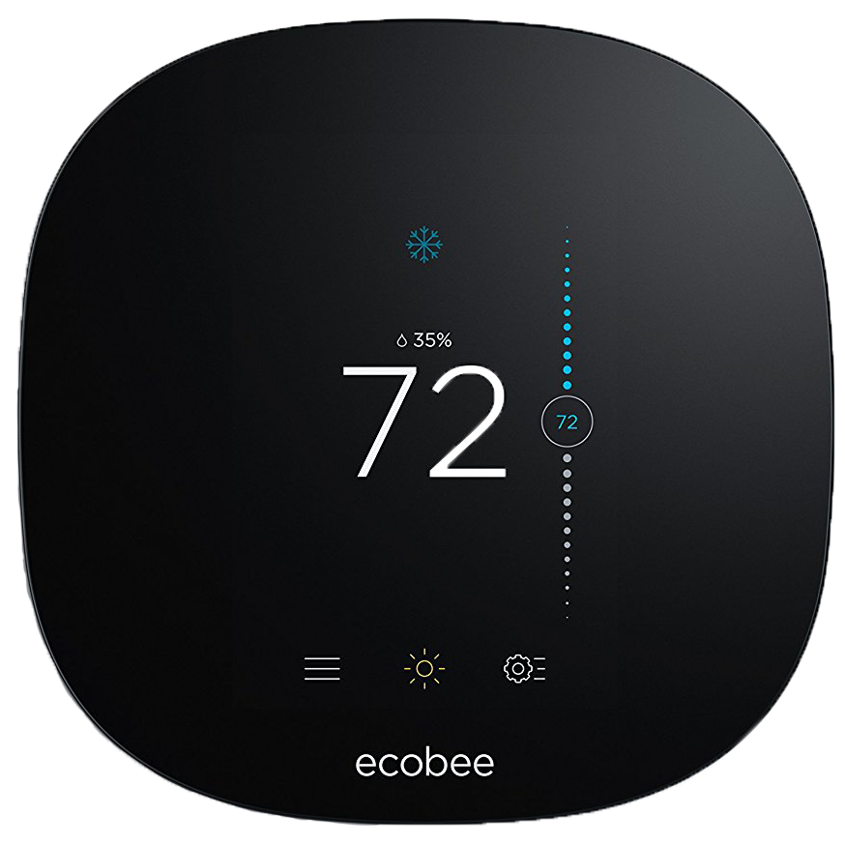
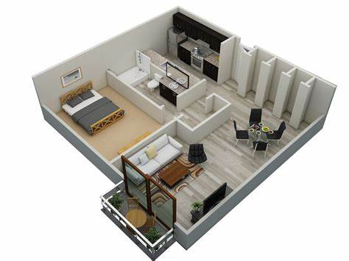
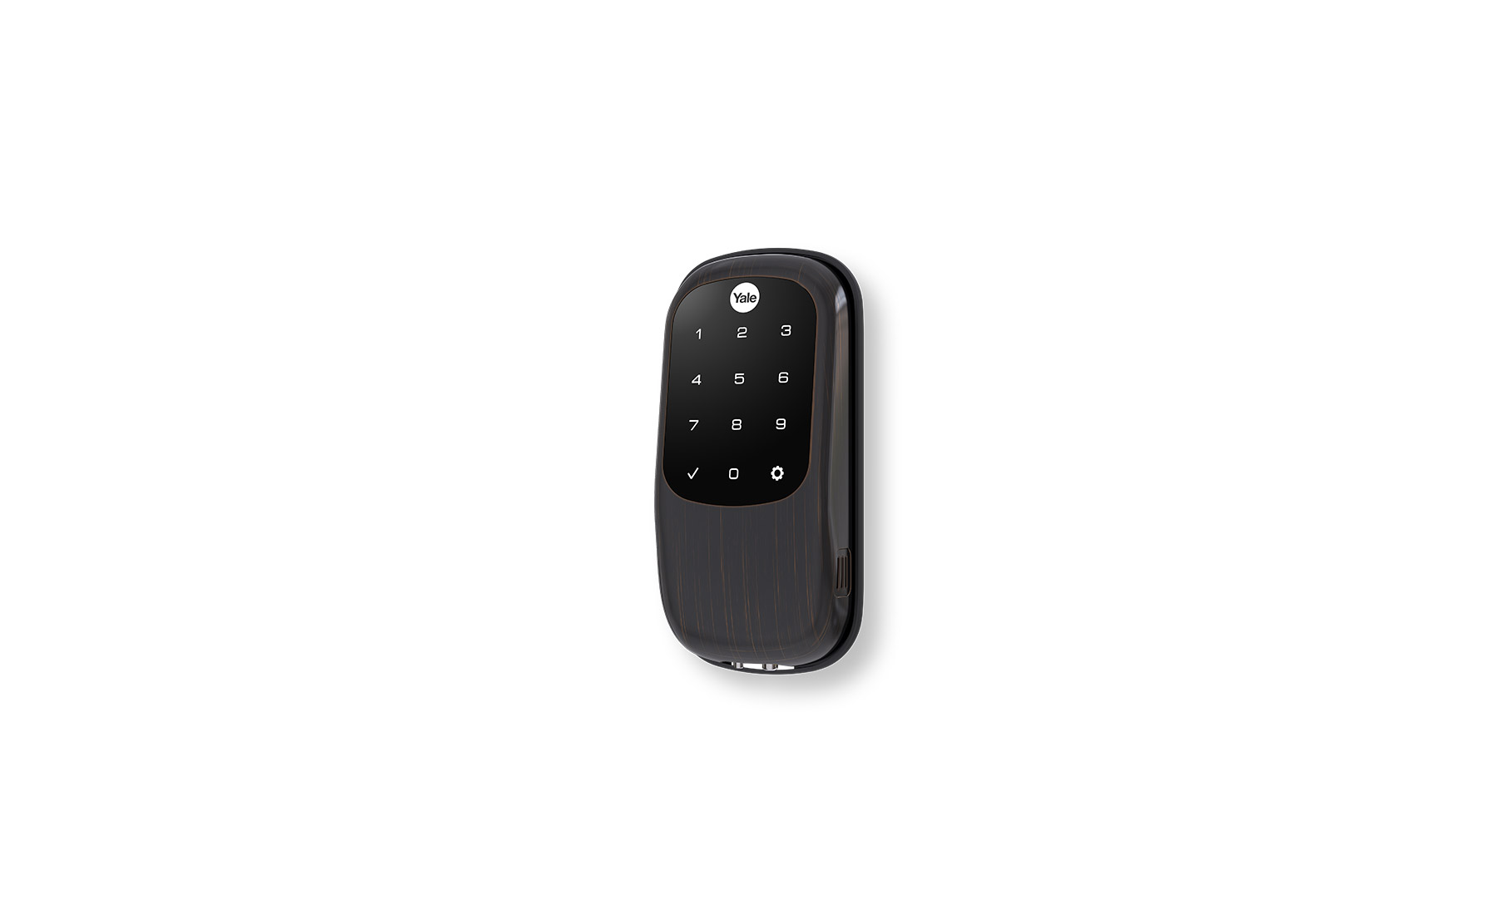

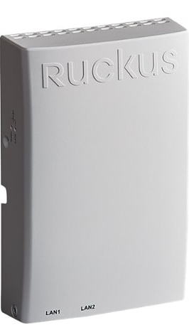
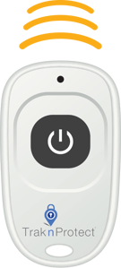
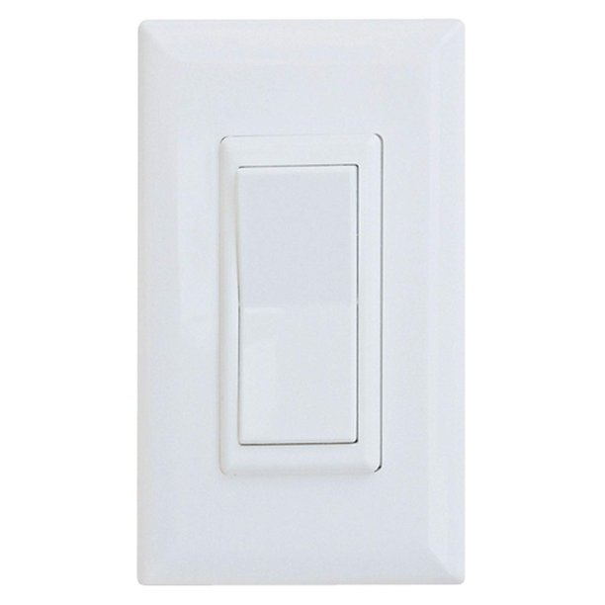
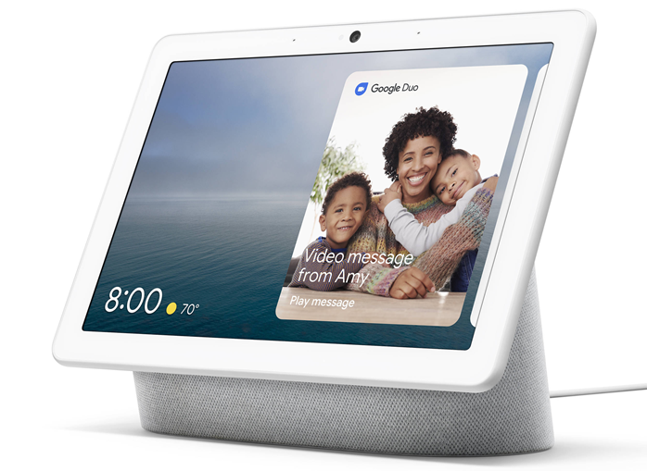
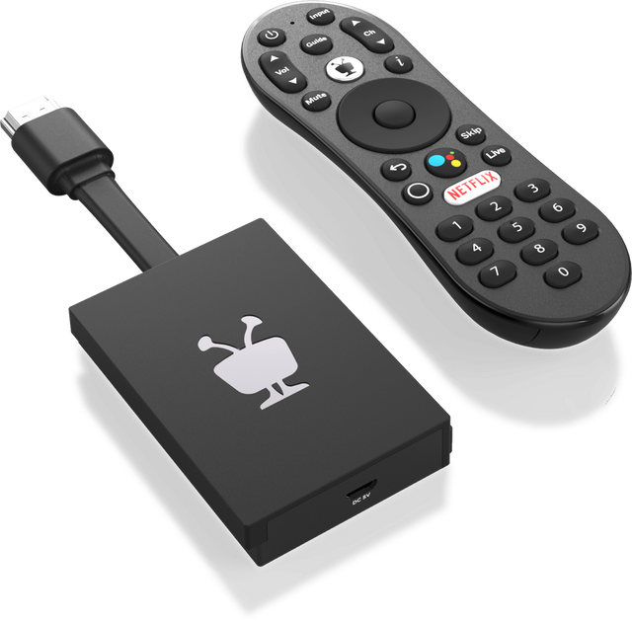

Leisure World Help Chat App:
Leak Detection
Alerts
Incident Records
Wi-Fi Connected
Wireless Door Contact
ZigBee Enabled
Wireless Door Contact
Managed Wi-Fi Devices
LW Disaster Help Chat App
Motion Sensor via Thermostat (optional)
Fall-down Device Sensor (optional)
Resident Thermostat Control (optional)
Secondary Device Options: Phase II
Additional Occupancy Notifications
Resident Thermostat Control
Connected Music Speakers (Ie. Sonos)
Smart Door Lock
Alerts
App Based
Wi-Fi – BLE - Zigbee
Safety Device Systems
Emergency Alerts (ie. Fall Down)
Incident Records
Locations Specific (geo-location)
Works anywhere Managed Internet is installed
Community Managed Wi-Fi
Internet can now be used as a disaster communication resource
Ancillary benefits allowing Smart Building and IoT technology
Help and Chat availability
Door Locks
Smart Thermostats
Voice Controls
Leak Detection
Resident Safety Devices
Smart Dimmer Switch
ZigBee Enabled
Voice Control Via Google Assistant
Google Assistance App – Phase ll
Voice Enabled Commands
Voice Controlled Prompts For Resident devices
Ie. Emergencies, Control Smart Devices
TV
LW Community Channel
Voice Enabled Remote
Emergency Alerts
LW Information Channel
Interact Technologies - Confidential & Proprietary - 2024

Slide 6
Thank You
Interact Technologies - Confidential & Proprietary - 2024

